Slide 1
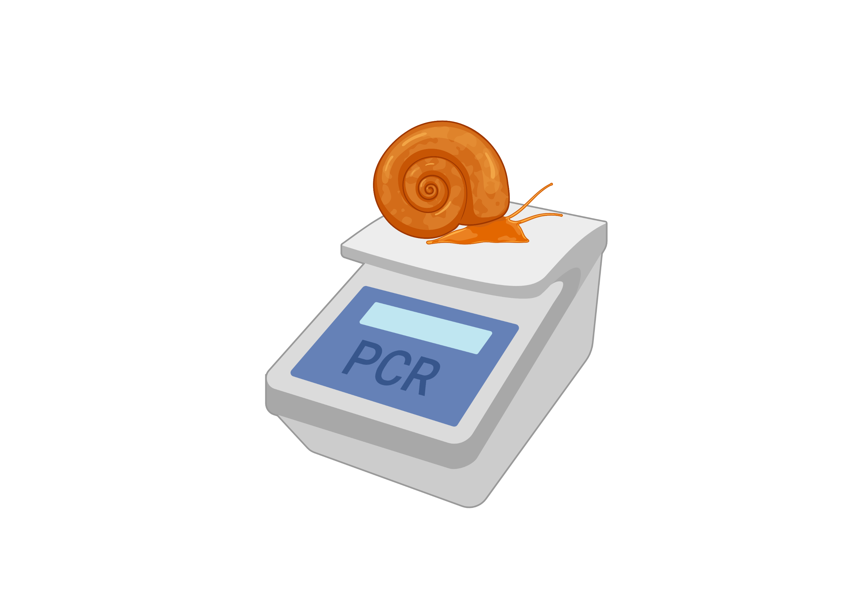
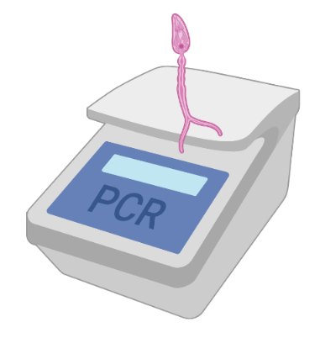


PCR-based diagnostic tools to detect and characterize trematode infections in snails
Ruben Schols, Cyril Hammoud and Tine Huyse

Slide 2
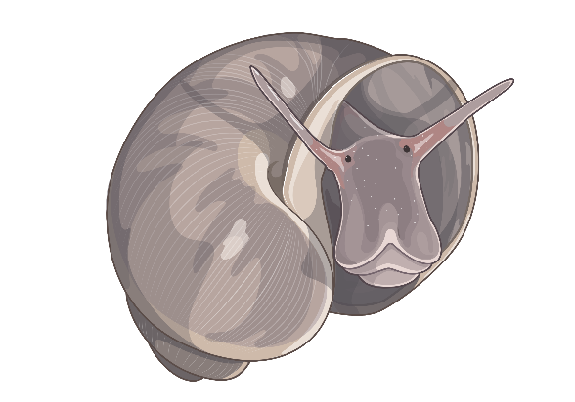

Intro
WHO GUIDELINE on control and elimination of human schistosomiasis (2022)
  6.2.2 Diagnostic tools for detection of Schistosoma in snails and the environment to verify elimination of transmission
  Shedding, Crushing, LAMP, eDNA, qPCR
  BUT no mention of standard PCRs!

Slide 3


PCR-based protocols
Overview
Two-step approach:
  Infection RD-PCR (Schols et al., 2019)
  Schistosoma RD-PCR (Schols et al., 2019)
HTAS (Hammoud et al., 2022)
Adapted HTAS (unpublished)

Slide 4
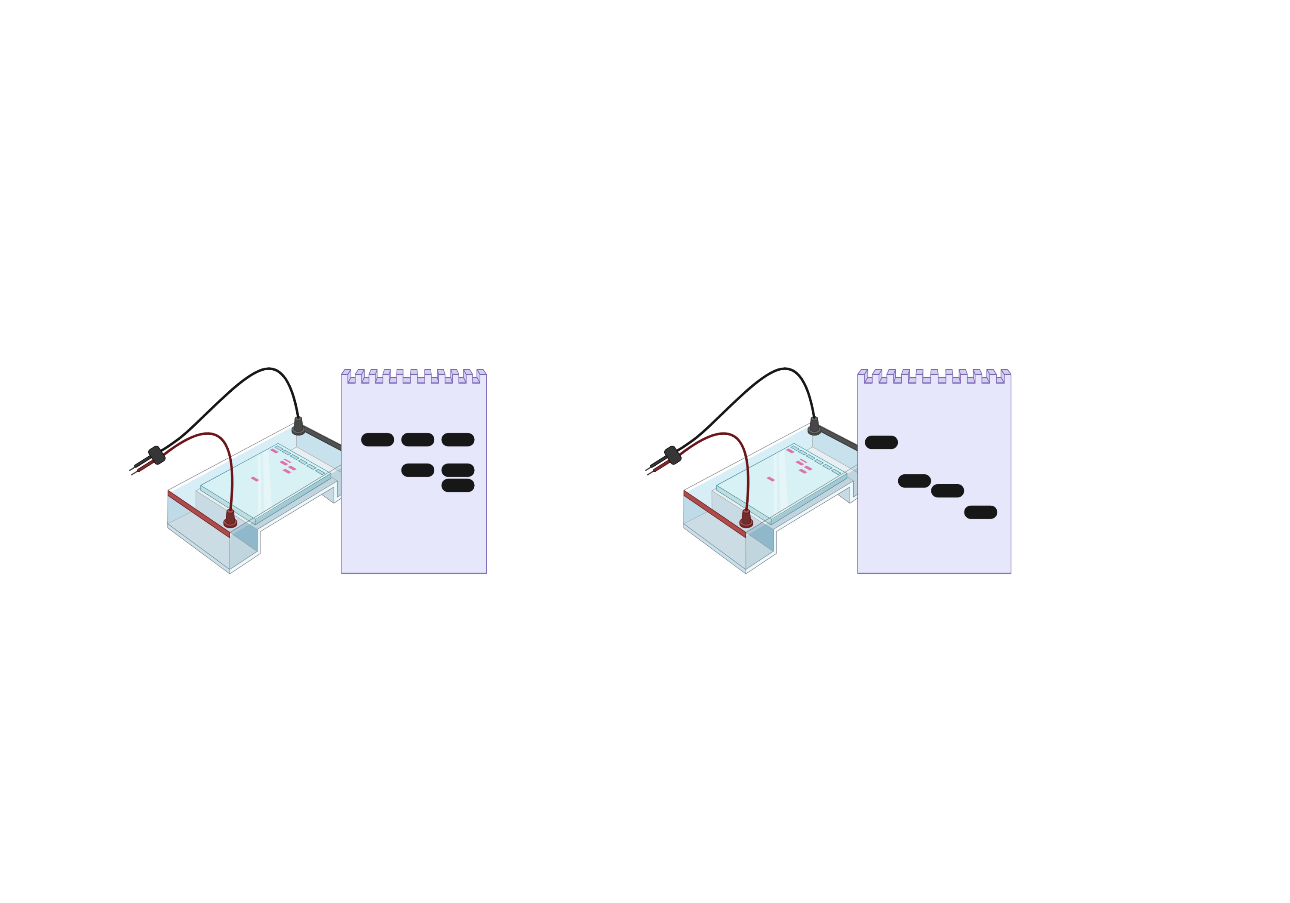
Infection RD-PCR
Determine infection status
Two-step
Schols et al., 2019
Snail marker
Trematode marker
Schistosoma spp. marker
Schistosoma sp. infected
Trematode infected
Non-infected

Slide 5
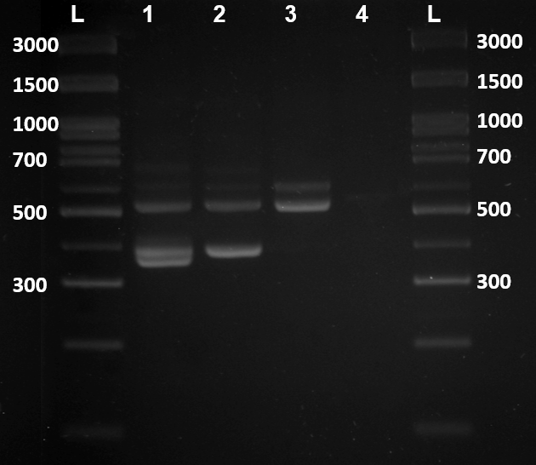
Two-step
Snail marker
Trematode marker
Schistosoma spp. marker

Slide 6
Schistosoma RD-PCR
Two-step
Identify Schistosoma species based on COX1
S. haematobium
S. mansoni
S. mattheei
S. bovis / S. curassoni / S. guineensis
Adapted protocol from:
Webster BL, Rollinson D, Stothard JR, et al. Rapid diagnostic multiplex PCR (RD-PCR) to discriminate Schistosoma haematobium and S. bovis. J Helminthol. 2010;84(1):107–14.
Van den Broeck F, Geldof S, Polman K, et al. Optimal sample storage and extraction protocols for reliable multilocus genotyping of the human parasite Schistosoma mansoni. Infect Genet Evol. 2011;11 (6):1413–8.
Schols et al., 2019

Slide 7
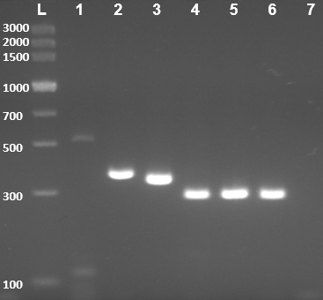
Two-step
S. haematobium
S. mansoni
S. mattheei
S. bovis / S. curassoni / S. guineensis

Slide 8
Costs
Two-step
Step | Product | Estimated cost/sample | Subtotals
DNA extraction | E.Z.N.A. DNA extraction kit (483 € / 200 U) | 2,42 € | 3,46 €
 | Qubit (1,04 € / 1 U) | 1,04 €
Infection RD-PCR | QIAGEN multiplex kit (2096 € / 3000 U) | 0,63 € | 0,67 €
 | 6 primers (~10€ / primer / 1500 U) | 0,04 €
Schistosoma RD-PCR | QIAGEN multiplex kit (2096 € / 3000 U) | 0,63 € | 0,66 €
 | 5 primers (~10€ / primer / 1500 U) | 0,03 €
 |  | TOTAL | 4,13-4,79€
Step | Product | Estimated cost/sample | Subtotals
DNA extraction | CHELEX (220 € / 2000 U) | 0,11 € | 0,11 €
 | (NanoDrop) | 0 €
Infection RD-PCR | QIAGEN multiplex kit (2096 € / 3000 U) | 0,63 € | 0,67 €
 | 6 primers (~10€ / primer / 1500 U) | 0,04 €
Schistosoma RD-PCR | QIAGEN multiplex kit (2096 € / 3000 U) | 0,63 € | 0,66 €
 | 5 primers (~10€ / primer / 1500 U) | 0,03 €
 |  | TOTAL | 0,78-1,44€

Slide 9
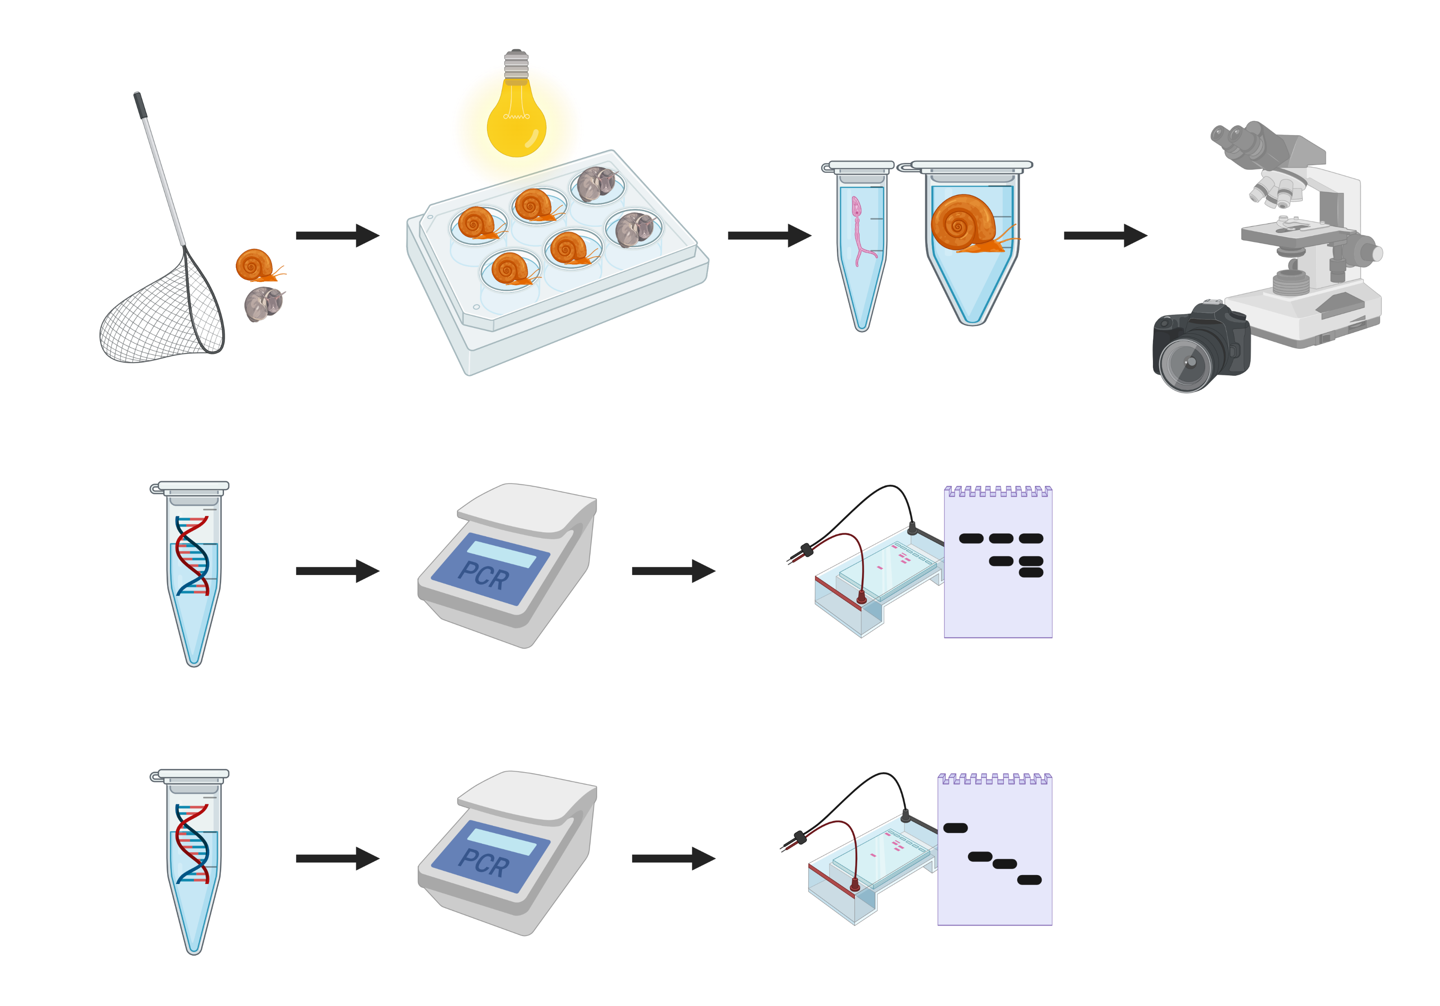
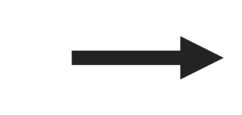
Two-step
Infection RD-PCR
Further analyses
Optional but beneficial
Schistosoma RD-PCR

Slide 10
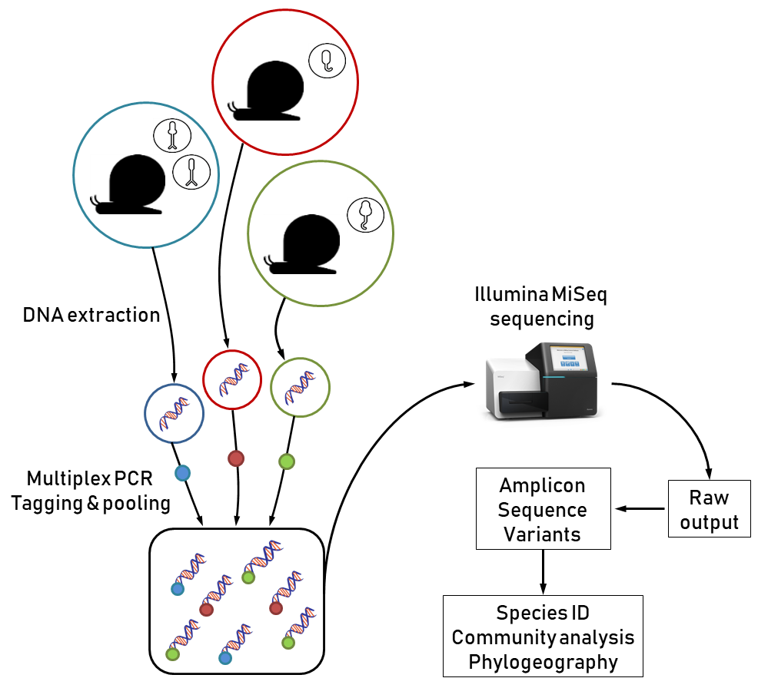

Further analysis - HTAS
Hammoud et al., 2022

Slide 11
Further analysis - HTAS
COI1
COI2
ITS2
cytb
NAD1
COI1
COI2
ITS2
cytb
NAD1
Primer amplifi-cation
70%
40%
100%
30%
90%
0%
90%
0%
40%
100%
0%
0%
100%
0%
0%
COI1
COI2
ITS2
cytb
NAD1
1. For each marker: species delineation using ASAP (+ GenBank sequences for validation)
2. Linking markers together using frequency of co-occurrence in snails
3. Validating some profiles using Sanger sequencing on field collected cercariae
Species puzzling
Observed
profiles

Slide 12
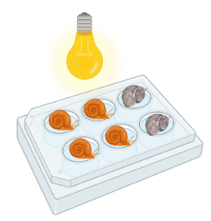
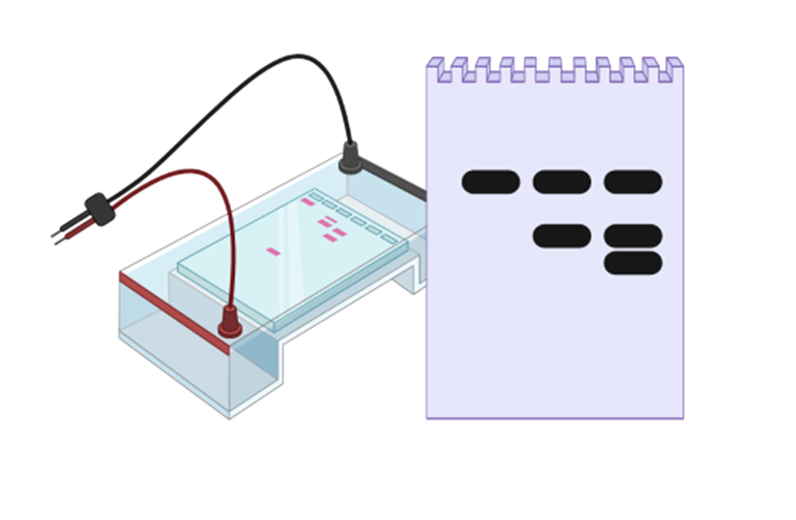


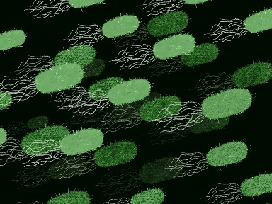

MicroResist
Further analysis – 16S
Project video: https://youtu.be/zqM6BBtyxao
HTAS
INFECTED
UNINFECTED
ALL
Shedding experiment
Infection RD-PCR
16S metabarcoding
Sanger sequencing

Slide 13
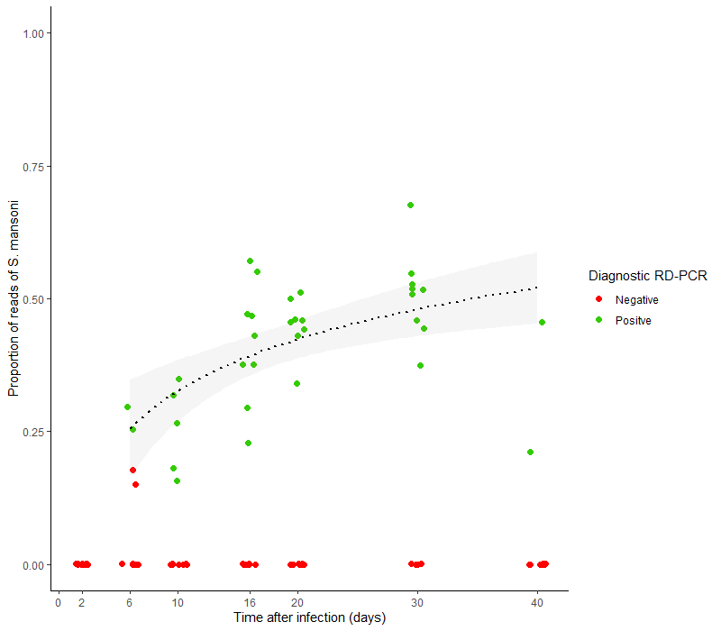
Validation and field testing
Two-step
Both RD-PCR and HTAS were used to characterise:
  experimental infections by S. mansoni (2 strains) and S. rodhaini from 417 snails (223 were infected, the rest uninfected). The diagnosis were congruent between both methods for > 98 % of snails.
  Field samples from 2,478 Bulinus snails from Uganda (848 were infected, the rest uninfected). 96.2 % of the infected snails yielded matching HTAS profiles.
+-2,000 snails from Zimbabwe, Senegal, and South-Africa of which +-200 were shedding. Shedding and sanger sequencing match output from RD-PCRs.

Slide 14
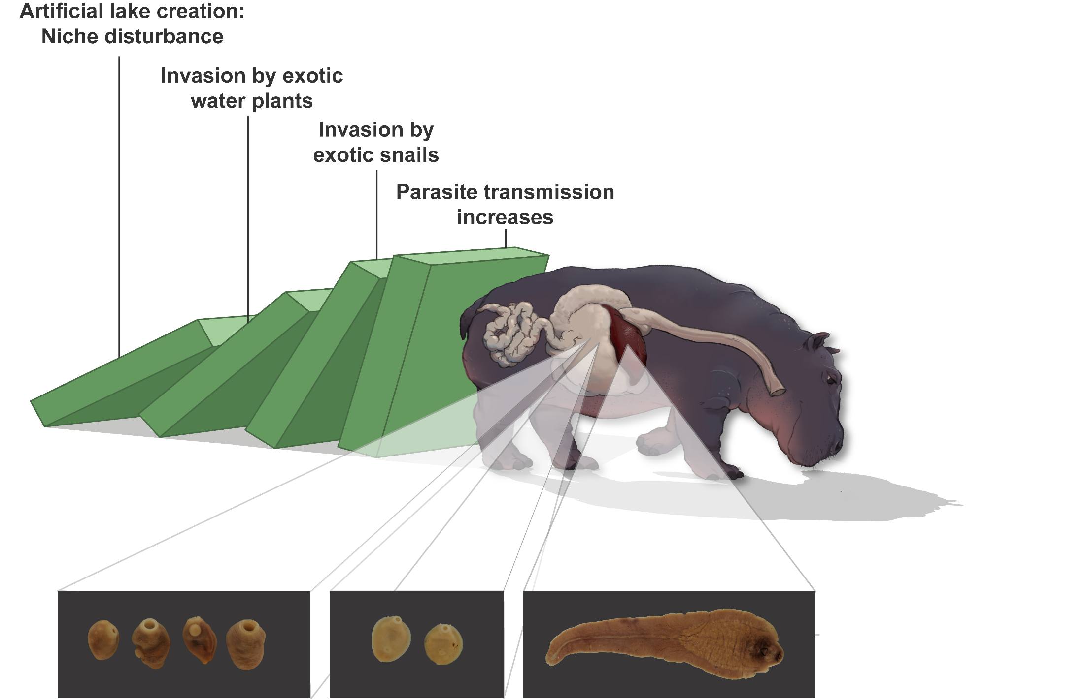

Invasive snails drive parasitic diseases of hippos in artificial lakes of Zimbabwe
Bonus
Schols et al., 2021

Slide 15

Maybe next time the PCR-based techniques will earn a special mention in the WHO report
Thank you for your attention!
Ruben Schols, Cyril Hammoud and Tine Huyse

Slide 16
References
Carolus, H., Muzarabani, K. C., Hammoud, C., Schols, R., Volckaert, F. A. M., Barson, M., et al. (2019) ‘A cascade of biological invasions and parasite spillback in man-made Lake Kariba’, Science of the Total Environment, 659, pp. 1283–1292. doi: 10.1016/j.scitotenv.2018.12.307.
Schols, R., Carolus, H., Hammoud, C., Mulero, S., Mudavanhu, A. and Huyse, T. (2019) ‘A rapid diagnostic multiplex PCR approach for xenomonitoring of human and animal schistosomiasis in a “One Health” context’, Transactions of The Royal Society of Tropical Medicine and Hygiene, 113(11), pp. 722–729. doi: 10.1093/trstmh/trz067.
Schols, R., Carolus, H., Hammoud, C., Muzarabani, K. C., Barson, M. and Huyse, T. (2021) ‘Invasive snails, parasite spillback, and potential parasite spillover drive parasitic diseases of Hippopotamus amphibius in artificial lakes of Zimbabwe’, BMC Biology, 19(1), p. 160. doi: 10.1186/s12915-021-01093-2.
Hammoud, C., Mulero, S., Van Bocxlaer, B., Boissier, J., Verschuren, D., Albrecht, C., et al. (2022) ‘Simultaneous genotyping of snails and infecting trematode parasites using high-throughput amplicon sequencing.’, Molecular ecology resources, 22(2), pp. 567–586. doi: 10.1111/1755-0998.13492.
Most icons were created with BioRender.com

Slide 17

Pros and cons workflow
Two-step
From snail collection to RD-PCRs
Efficient downstream resource allocation
Relatively simple molecular procedure
Inventorying biodiversity (One Health)
Additional metadata
Simple interpretation of GE
Flexible workflow
Reliable and well validated
Relatively costly compared to shedding
Molecular lab required
Sampling bias in snail collection
Skill transfer is currently limited
  + (note: visitors)
GE takes time
Entire workflow demands time
Snail taxa limitation
  (Physella acuta issue)

Slide 18
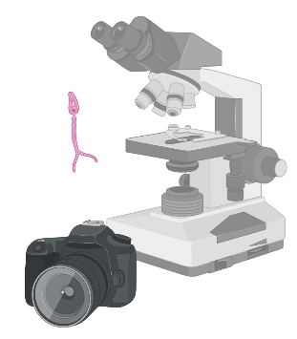

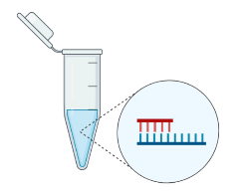
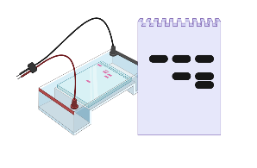
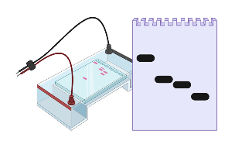
Timing for 144 snail samples
Two-step
Cercarial imaging – 3 days
Snail imaging – 2,5 days
EZNA DNA extraction – 3 days / 72 samples
RD-PCRs – 1,5 days
CHELEX DNA extraction – 1,5 days / 72 samples

Slide 19
HTAS costs
HTAS
Step | Product | Estimated cost/sample | Subtotals
DNA extraction | E.Z.N.A. DNA extraction kit (483 € / 200 U) | 2,42 € | 3,46 €
 | Qubit (1,04 € / 1 U) | 1,04 €
HTAS | Platinum multiplex kit (598 € / 1000 U) | 0,60 € | €14,4
 | 8 primers (~40 € / primer / 1000 U) | 0,32 €
 | Bead purification (0,3 € / 1U) | 0,30 €
 | Library prep Genomics Core (10 € / 1 U) | 10,00 €
 | MiSeq v2 (1835 € / 576 U) | 3,18 €
 |  | total | €17,86

Slide 20
Costs RD-PCRs
Two-step
Step | Product | Estimated cost/sample | Subtotals
DNA extraction | CHELEX (220 € / 2000 U) | 0,11 € | 0,11 €
 | (NanoDrop) | 0 €
Infection RD-PCR | QIAGEN multiplex kit (2096 € / 3000 U) | 0,63 € | 0,67 €
 | 6 primers (~10€ / primer / 1500 U) | 0,04 €
Schistosoma RD-PCR | QIAGEN multiplex kit (2096 € / 3000 U) | 0,63 € | 0,66 €
 | 5 primers (~10€ / primer / 1500 U) | 0,03 €
 |  | TOTAL | 0,78-1,44€
Step | Product | Estimated cost/sample | Subtotals
DNA extraction | E.Z.N.A. DNA extraction kit (483 € / 200 U) | 2,42 € | 3,46 €
 | Qubit (1,04 € / 1 U) | 1,04 €
Infection RD-PCR | QIAGEN multiplex kit (2096 € / 3000 U) | 0,63 € | 0,67 €
 | 6 primers (~10€ / primer / 1500 U) | 0,04 €
Schistosoma RD-PCR | QIAGEN multiplex kit (2096 € / 3000 U) | 0,63 € | 0,66 €
 | 5 primers (~10€ / primer / 1500 U) | 0,03 €
 |  | TOTAL | 4,13-4,79€

Slide 21
